Slide 1
How to ‘Request Review by Another IRB’
A Guide for VUMC Principal Investigators and Study Teams Using Another IRB for Multi-Site Studies
Notes:
Version 09/28/2026

Slide 2
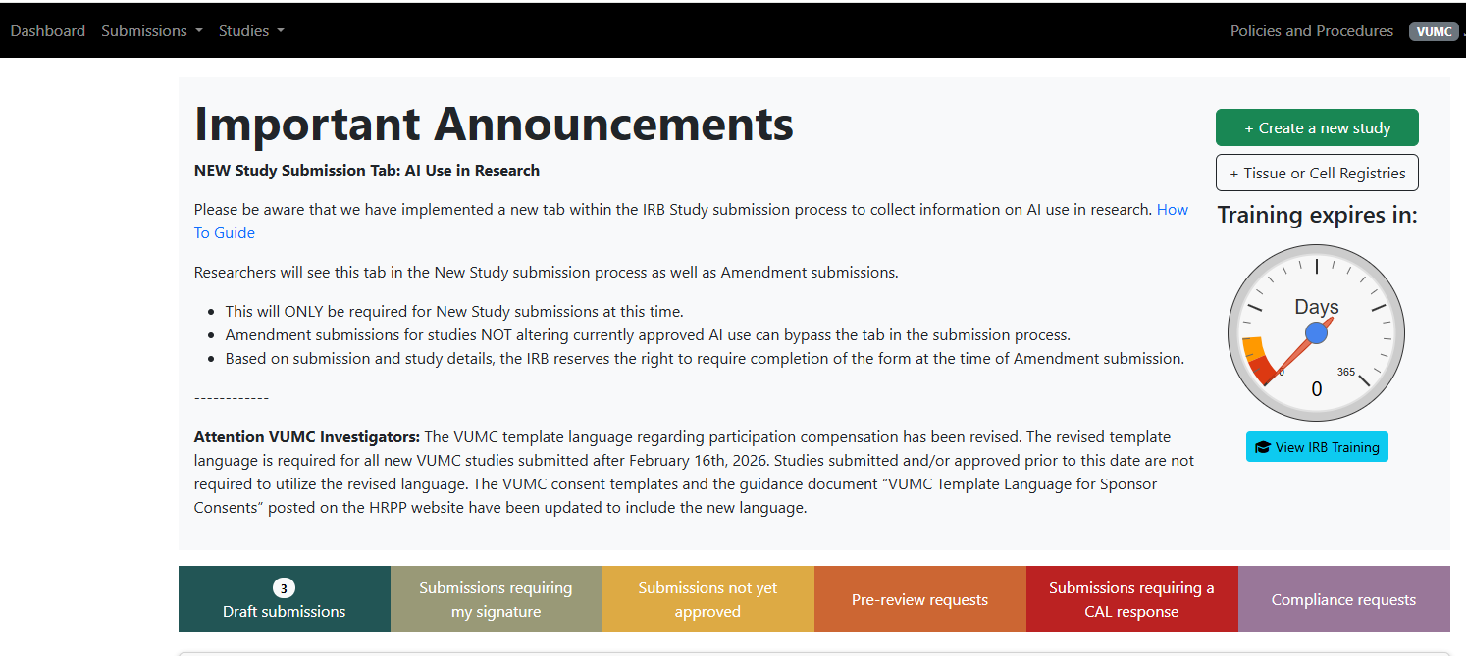
Create a new study submission in DISCOVR-e

Slide 3
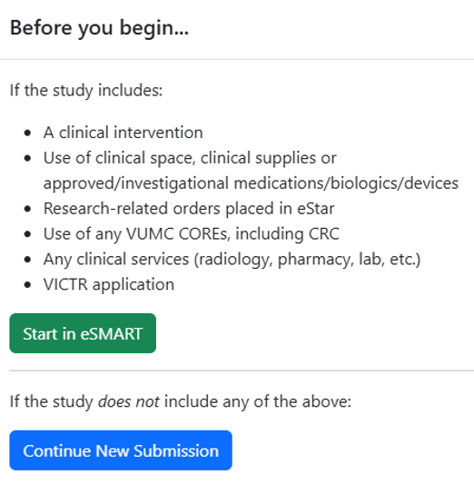
POP-UP Question:
Before you begin the submission in DISCOVR-e, respond to eSMART question
eSMART provides data for eStar study set-up, including the routing of research related patient care charges. eSMART is a separate system from the DISCOVR-e study submission system and not managed by the VUMC HRPP. Contact Clinical Research Fiscal Support Services at crfss@vumc.org
Note: Training resources and user manuals for eSMART applications can be found in StarBRITE. If you need further assistance, please contact Clinical Research Fiscal Support Services at crfss@vumc.org

Slide 4
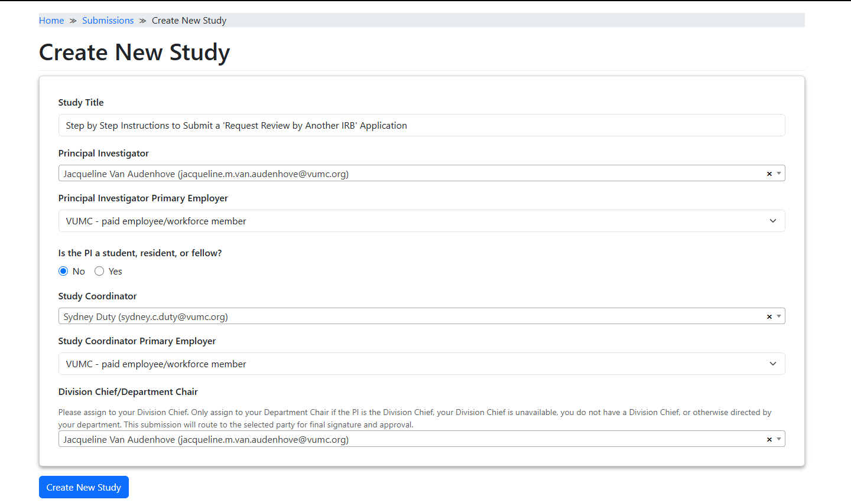
CREATE NEW STUDY - MAIN TAB
Complete study title to align with title on the protocol.
Fill in PI, SC fields as applicable including Primary Employer field.
Division Chief/Department Chair field is a required field. As a reminder, the submission will not move to the VUMC HRPP global inbox until the PI & Division Chief/Department Chair signs-off.

Slide 5
Begin as you normally would and complete all tabs
Important Notes when ceding to an External IRB
All fields in the KSP tab must be completed.
The Funding/Support tab requires a Worktag number. If the study is not federally funded, contact the sIRB manager/team.
The Performance Sites tab requires providing location of research if research activities occur outside 21st Avenue campus to ensure the site is an approved research site. The rest of the tab should be left blank.
A new AI Usage tab requires confirmation regarding the use of AI.

Slide 6
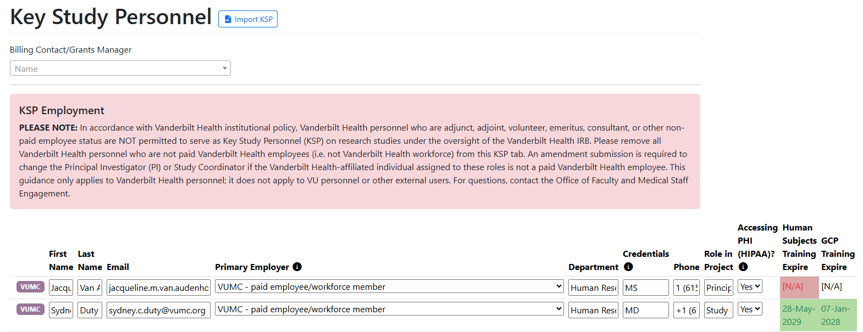
COMPLETING THE KSP TAB
Important Notes:
All fields must be completed on the KSP tab.
Primary Employer field verifies if all KSP are paid VUMC employees.
PI and Study Coordinator are required to complete Human Subjects training & sIRB training when submitting a sIRB submission.
All KSP required to complete Human Subjects training, and, when applicable, GCP training.

Slide 7
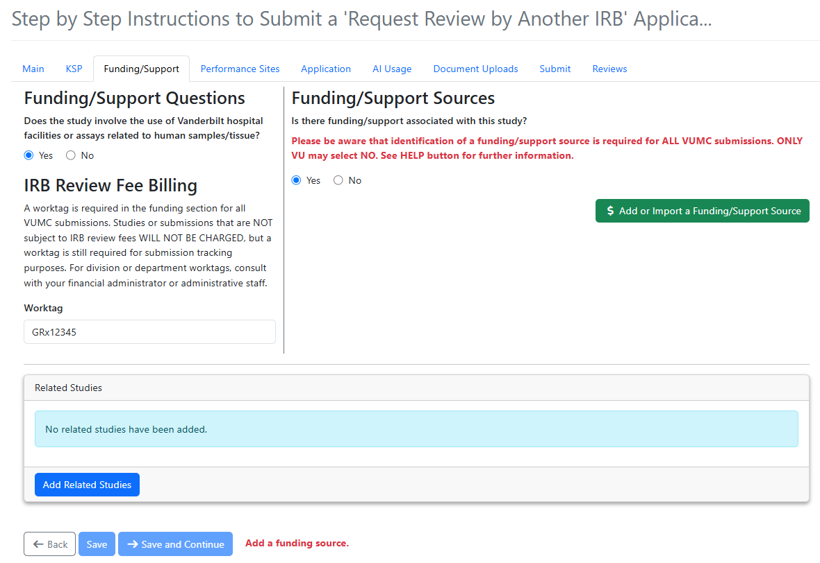
COMPLETING THE FUNDING TAB
Important Notes:
Import the funding from PEER if available. Otherwise, complete manually by adding funding type, source, and contract/grant#.
For ceded submissions, if the source of funding is not federal, contact the singleirb@vumc.org to discuss.
A VUMC Worktag number is required.

Slide 8
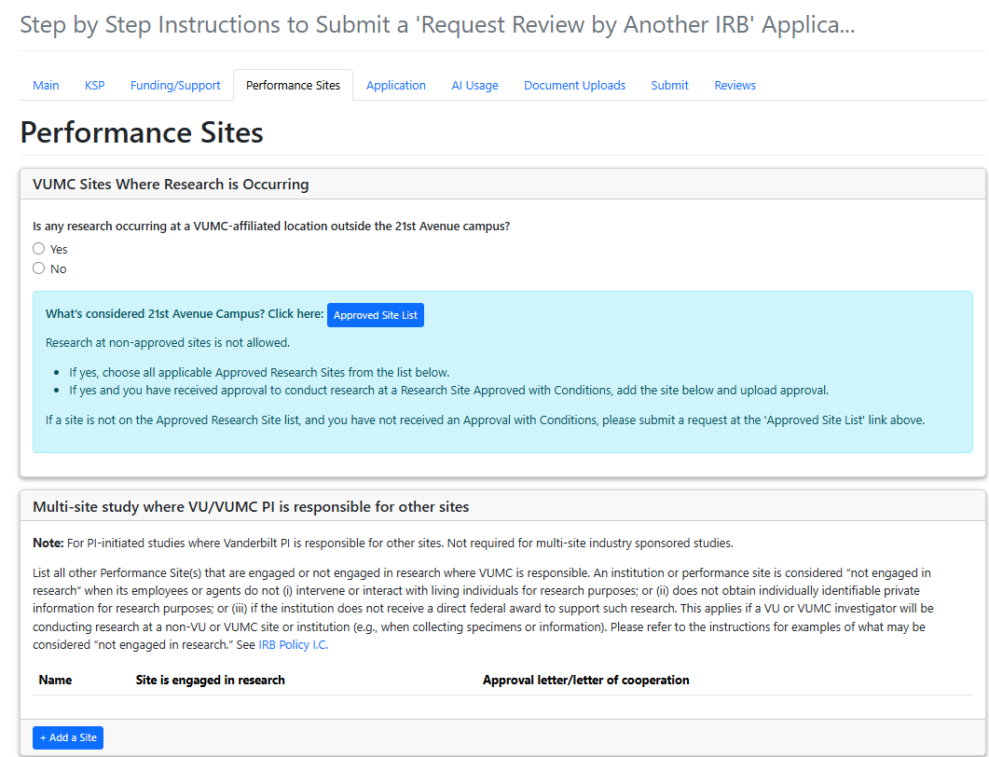
COMPLETING THE PERFORMANCE SITES TAB
When ceding to another IRB, the location where research activities will occur should only include approved research locations. If research occurs at a VUMC-affiliated location outside the 21st Avenue campus, the site must be on the“Approved Site List.”
The “Multi-site study where VU/VUMC PI is responsible for other sites” section is not applicable when the VUMC IRB is ceding review to another IRB. Letters of Support should uploaded within DISCOVR-e when applicable
Notes:
For ceded studies, the PI should submit letter of supports for sites in the admin tab where VUMC staff conducts research there but are not otherwise engaged.

Slide 9
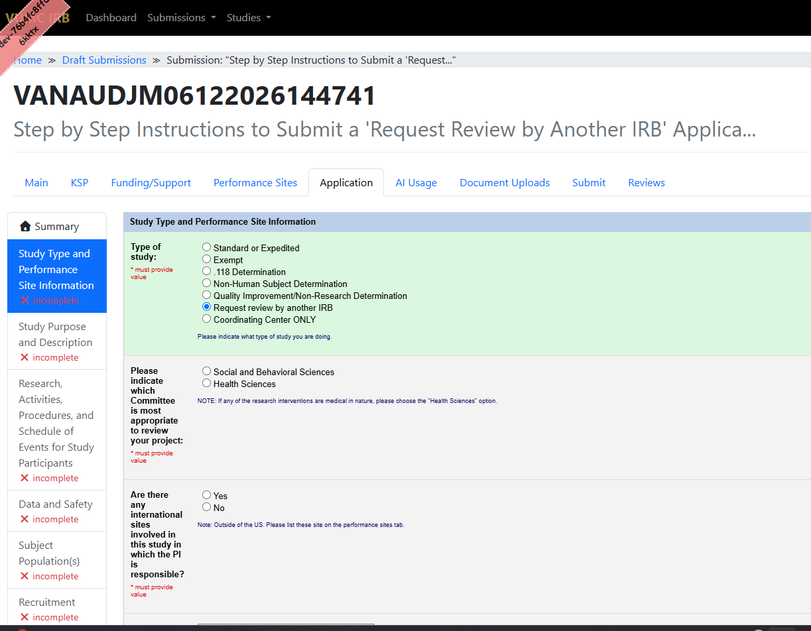
COMPLETING THE APPLICATON
For “Study Type and Performance Site Information”, select Request review by another IRB.
This is an abbreviated application in DISCOVR-e that provides VUMC HRPP with information about the VUMC study team’s involvement in the research. This information allows the VUMC HRPP to determine what local considerations may apply, such as consent form boilerplate language, ancillary reviews (i.e., radiation safety review), and state laws or institutional policies.

Slide 10
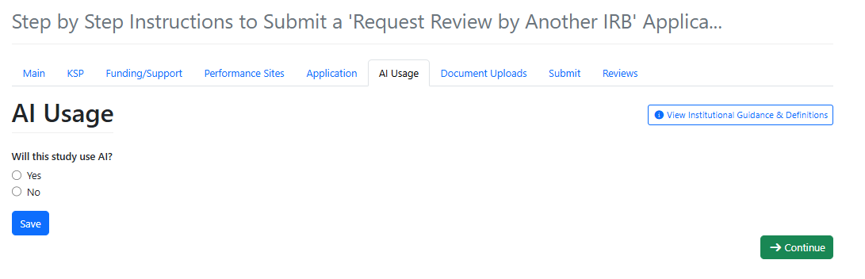
COMPLETING THE AI TAB
Completion of the “AI Usage” tab is a required for all New Study submissions. If answered “yes” to the question related to AI Usage, additional questions will populate to capture more detailed information.
For ceded studies using AI, there may be a need for an AIT review. This would be a local ancillary review in addition to the HRPP review.

Slide 11
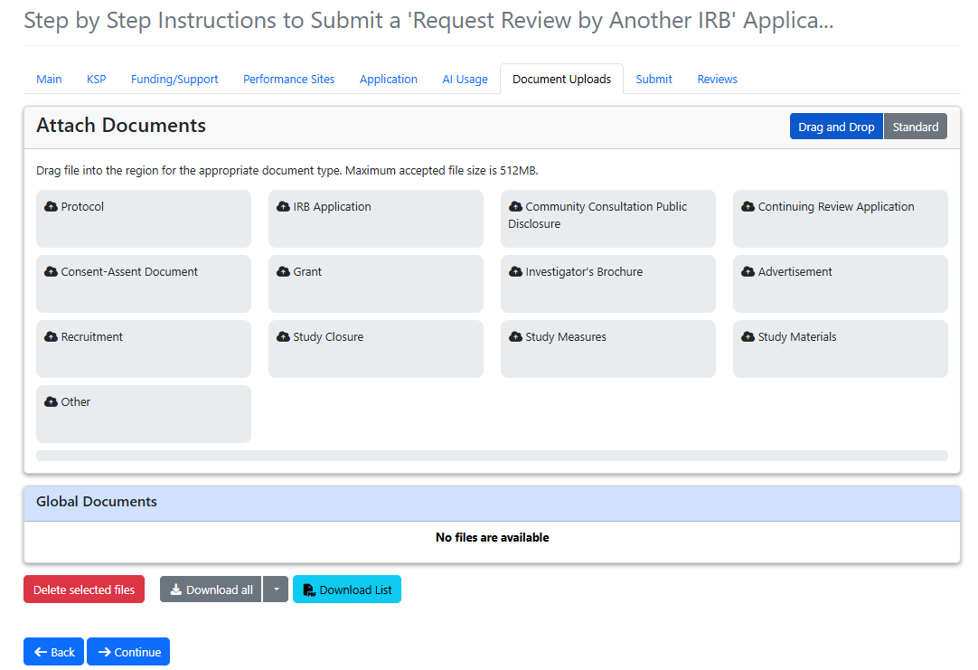
The following documents should be submitted for local review and placed in the applicable bucket:
Reliance agreement if available (e.g. SMARTIRB Agreement, Letter of Acknowledgement )
Local context forms from the Reviewing IRB for the VUMC HRPP and study team to complete in coordination
Overall initial IRB approval letter and current continuing review approval letter (if applicable) from the Reviewing IRB.
Consent Form(s)
a copy of Master Sponsor consent template
a tracked and a clean copy with VUMC local language included. (see Local Information document on the HRPP SIRB Webpage.)
VUMC Standalone HIPAA Authorization form
Other study documents approved by Reviewing IRB (as applicable)
Protocol
Investigational Brochure
Study Materials to be used at VUMC
COMPLETING DOCUMENTS UPLOAD TAB

Slide 12
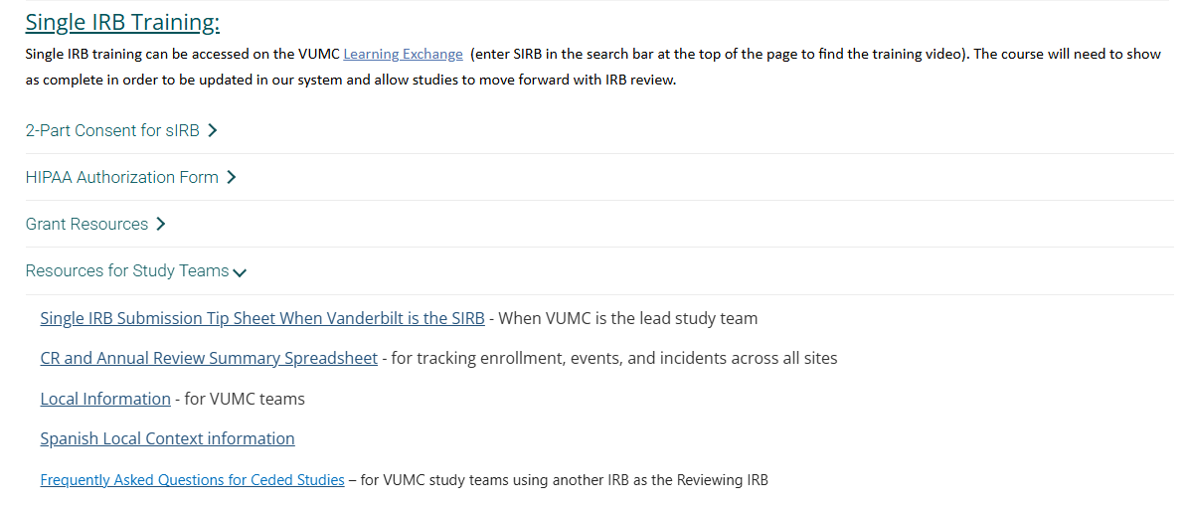
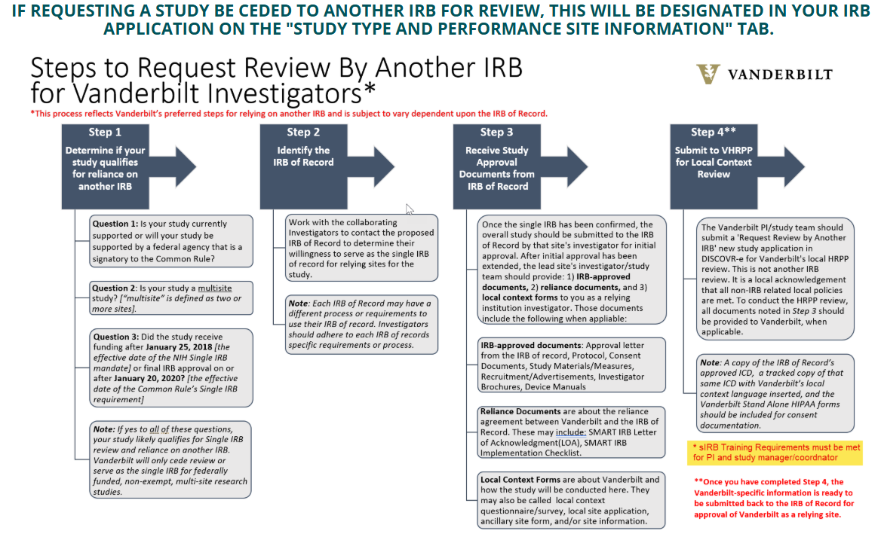
When all tabs have been completed, submit via the Submit Tab.
If you have questions throughout the process, please contact singleirb@vumc.org .
For additional guidance, please visit the VUMC HRPP website at https://www.vumc.org/irb/node/28

